Slide 1
Strategic Leadership
607MAN 303MAN
Analysing strategic resources & capabilities
Week 2 – S7

Slide 2



What we’re going to cover today…
(1)
Organisations
Resources and
capabilities
(2)
Adding value
(3)
Identifying
strategic
Capabilities

Slide 3
Session Outcomes
Evaluate and apply conceptual and practical approaches to strategic leadership in a range of different organisational settings.
Analyse contemporary research on the role of leadership in managing change.
Critically assess the relevance of leadership styles to key sector changes including globalisation, internationalisation, strategy, technological innovation and organisation development.
Identify and critically reflect on leadership capabilities and strategies of key Business leaders across a range of sectors.
Evaluate an incident of strategic organisational change by exploring the role of leadership and the measurement and management of Key Performance Indicators (KPI’s).
Critically explore the ethical relationships between leaders and followers in relation to decision making, corporate governance and policy practices in organisations.

Slide 4


Report
Class discussion
30 minutes
What would you consider to be the resources and capabilities of most organisation?
Why are resources and capabilities important in strategy?

Slide 5
Organisation’s resources and capabilities

Slide 6
Why strategic resources and capabilities are important
Underpinning economic assumption: organisations wish to generate above-average returns
During the 1980s and 1990s, strategy took a fundamental shift from the market-based approach of Prof Porter and others towards a greater emphasis on the competitive resources of an individual company
The new approach was called the Resource-based View (RBV) of the organisation
Notes:
See: Lynch Ch 4, Sections 4.1 and 4.6

Slide 7
Resource-Based View
RBV is an approach to achieving competitive advantage that emerged in 1980s and 1990s, after the major works published by Wernerfelt, B. (“The Resource-Based View of the Firm”), Prahalad and Hamel (“The Core Competence of The Corporation”), Barney, J. (“Firm resources and sustained competitive advantage”) and others.
The supporters of this view argue that organizations should look inside the company to find the sources of competitive advantage instead of looking at competitive environment for it.

Slide 8
Resource-based view (RBV) of strategy development
Resource-based view (RBV) of strategy development represents revised view of strategy development.
Focuses on the individual resources of the organisation, rather than strategies common to all companies in an industry.
Basic argument: important to understand the competitive forces in an industry, but organisations should seek their individual solutions within this context.
Competitive advantage: derives from the exploitation of the relevant resources of the individual organisation when compared to others in the industry.
Keypoint: RBV represents newer insight
(Lynch 2012)
Notes:
See Lynch Ch. 4, Section 4.6

Slide 9
Why are strategic resources and capabilities important?
Value added: the company’s profits over time
..Because they deliver value added
Why are resources and capabilities important in strategy?
Competitive advantage: its brands, patents, distribution, etc.
…Because they deliver competitive advantage
(Lynch 2018)

Slide 10
Adding value

Slide 11
Identifying value added
Begin with broad survey of value added in organisation:
Products or services – the size, range and profitability of the organisation’s main products or services
Competitive position – the relative market position, the relative quality of service and reputation, the relative costs
Leadership and people – the people who make up the organisation, their skills, size and leadership
Suppliers and customers -the relationships that the organisation has with its outside networks
(Lynch 2018)

Slide 12
How can we identify value added?
Added value through better organisation structure, leadership and human resources than its competitors across many areas of the company
Added value through superior research and development and through exceptional procurement skills with outside companies compared to competitors
Added value from negotiating lower prices and higher quality from its suppliers
Added value through lower costs and more efficient distribution to customers
Added value from superior manufacturing through lower costs and high quality
Added value at the firm by its superior marketing and selling
Added value through higher levels of service to customers
The Value Chain of a Manufacturing Company: Where does it add more value than rivals?

Slide 13
How can we identify strategic resources and capabilities?-
Resources difficult to analyse because many of them are vague and difficult to identify, e.g. organisational skills
Useful to divide into three broad categories:
Tangible assets – the physical assets – e.g. plant and location
Intangible assets – resources that have no physical presence but provide benefits – e.g. brand names and patents
Organisational capability – the skills, routines, management and leadership of the organisation

Slide 14
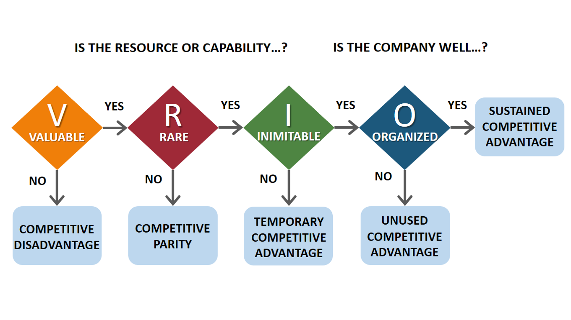
VRIO - Strategic capabilities and competitive advantage
The four key criteria by which capabilities can be assessed in terms of providing a basis for achieving sustainable competitive advantage are:
value
rarity
inimitability and
organisational support
Source: Barney (1991)
VRIO¹

Slide 15
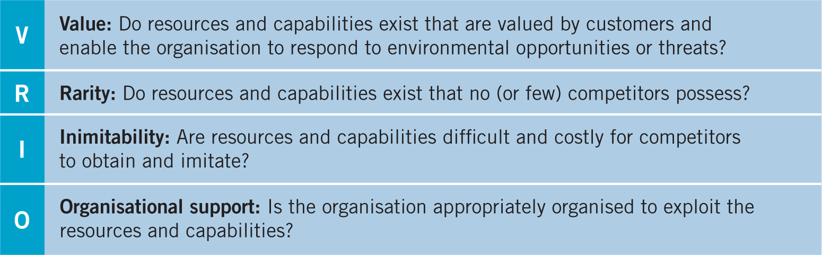
VRIO

Slide 16
Identifying strategic capabilities

Slide 17
Three key areas of focus – step 3
Distinctive capabilities from Barney 1991; 2001.
Core competences from Hamel and Prahalad 1990.
Knowledge from several sources
(Lynch 2012)
Notes:
Given the vague nature of the RBV, it is useful to have some additional guidance on how to identify the resources and capabilities of an organisation From a number of strategy studies, three areas may prove particularly useful:
But none of these is a substitute for a fundamental exploration of the organisation’s SCA and its sources of value added

Slide 18
Distinctive capabilities in 3 areas
Architecture: the network of relationships both within and outside the firm
Reputation: the standing of the firm in the community at large
Innovative ability: the structures, skills, procedures and rewards that allow some organisations to innovate better than others
(Lynch 2012)
Notes:
See: Lynch, Ch 4, Section 4.7

Slide 19
Core competencies
Core competencies: “a group of production skills and technologies that enables an organisation to provide a particular benefit to customers” - developed by Hamel and Prahalad
Can be built in a variety of ways in existing and new products to deliver competitive advantage
Three distinguishing features of successful core competences:
Customer value: must make a real impact on how the customer perceives the organisation
Competitor differentiation: competencies must be unique against competition
Extendable: core competencies need to be capable of providing the basis for products or services that go beyond those currently available
(Lynch 2017)
Notes:
Core competencies: “a group of production skills and technologies that enables an organisation to provide a particular benefit to customers” - developed by Hamel and Prahalad
Can be built in a variety of ways in existing and new products to deliver competitive advantage
See: Lynch, Ch 4, Section 4.7

Slide 20
Knowledge can deliver SCA
Knowledge can deliver SCA: important to distinguish between tacit and explicit knowledge
Tacit knowledge: difficult to specify, fuzzy, perhaps complex and often unrecorded
Explicit knowledge: carefully analysed, often defined precisely, often written down
Both types can provide sustainable competitive advantage
Tacit because it is more difficult for competitors to copy what remains only partially known
Explicit because it may be exclusive to the organisation, such as a patent.
Notes:
See: Lynch, Ch 4, Section 4.7

Slide 21
Sources of sustainable competitive advantage
Differentiation
Low costs
Niche marketing
High performance technology
Superior quality
Superior service
Vertical integration
Synergy
Culture, leadership and style of organisation
Notes:
Advantages over competitors that cannot easily be imitated
Sustainable over time by being deeply embedded in the organisation

Slide 22
What we’ve covered today…
(1)
Organisations
Resources and
capabilities
(2)
Adding value
(3)
Identifying
strategic
Capabilities

Slide 23

Traffic Light it
Where is your learning at?
Red = I have misunderstood some of the topics. (write down 2 questions that you need help with)
Amber = I have understood most of the topics so far (write down 1 question and 1 key theme you have understood)
Green = I have understood the topics so far (write down 2 key themes from the lesson to show your understanding)

Slide 24

Reading list
Essential Reading
Lynch, R., (2021) Strategic Management. 9th edn. London: Pearson Education
Yukl, G. (2020), Leadership in Organizations: Global Edition. 9th edn. Los Angeles: SAGE
Recommended Reading
Robbins, S.P., De Cenzo, D.A., Coulter, M. (2020) Fundamentals of Management: Management Myths Debunked! Global Edition. 11th edn. Harlow: Pearson
Johnson, G., Whittington R., Scholes K. (2020) Exploring Strategy: Texts and Cases. 12th edn. Harlow: Pearson.

